Slide 1
The Gospel of Matthew
Bible Study – Examination, Exposition, and Application
Chapter 13:1-52 – Parables about the Kingdom of God

Slide 2
Chapter 13 – Bigger Than We Expected
Parables about the Kingdom of God
v. 1 – That same day…by the Sea of Galilee (Tiberias)
Large crowd (throng) – taught from a boat
v. 2-3a – Parables: short stories from everyday life told to convey a spiritual or moral imperative
V. 10-17 – Reasons for Teaching in Parables
Quotes Isaiah 6:9-10 (Called and Commissioned to Preach)
Vivid, memorable images with personal implications
Convey truth without offending contentious listeners
V. 34-35 – Fulfill Prophecy, Asaph (2 Chr. 29:30, Ps. 78)

Slide 3
Chapter 13 – Bigger Than We Expected
Parables about the Kingdom of God
The Kingdom of Heaven (Gk. Basileias ton Ouranon) “kingship, sovereignty, authority, royal power, rule; the realm in which a king sovereignly rules”)
“Heaven” or G-d – periphrasis by pious Jews
“Thy will be done, on earth as it is in heaven”
R.T. France “what happens when God has his way, when his will is done and his purpose fulfilled” (Matthew, Tyndale New Testament Commentaries, IVP, p. 49)
Six stories about the secret (Gk. Musterion: secret, mystery, counsel of God revealed to humans): Sower of seed, weeds in the wheat, mustard seed, yeast, hidden treasurers/pearls of great price, dragnet

Slide 4
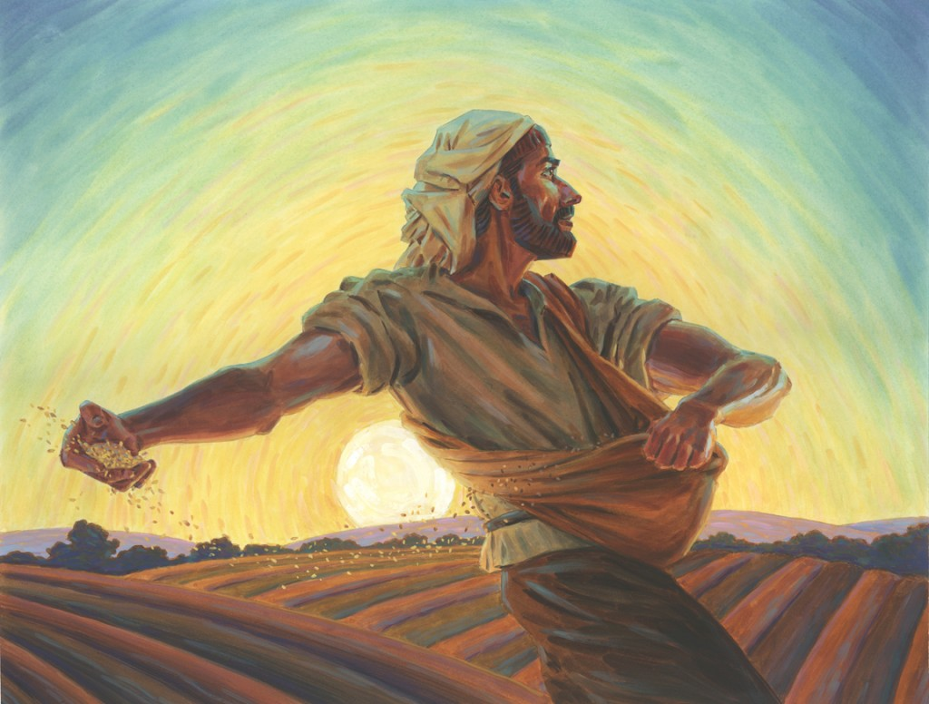
Chapter 13 – Bigger Than We Expected
Parables about the Kingdom of God
v. 3b-9, 18-23 – Parable of the Sower
Sower = God
Seed = faith
Places Where God “sows” (scatters seed)
The Path – birds = Evil One snatches
Rocky ground – not root (depth) = troubles / persecution
Thorns – chocked it = cares of this world / wealth
Good Soil – reproduced (100x, 60x, 30x)
Let anyone with ears listen! (spiritual receptors)

Slide 5
Chapter 13 – Bigger Than We Expected
Parables about the Kingdom of God
v. 24-30, 36-43 – Parable of the Weeds in Wheat
Someone (Gk. Anthropo) – sowed good seed
Everyone sleeping – an enemy sowed tares
Plants bore grain – weeds appeared
Slaves blame Landowner and asked to tear out tares
Unintentional Harm – uprooting the immature
God’s Ultimate Justice - God allows good and evil to co-exist until the end of human history (to be burned and barned)
Evil does not stop the Righteous from Maturing/Reproducing
Daniel 12:3

Slide 6
Chapter 13 – Bigger Than We Expected
Parables about the Kingdom of God
v. 31-32 – Parable of the Mustard Seed
Someone sowed mustard seed (smallest)
Grew into the greatest of shrubs (empire)
Birds of the air come and nest (security)
God blessing to all nations (Gk. Ethnos; Gen. 22:18)
v. 33 – Parable of the Yeast
A woman mixed yeast into (4L) flour to 100 people
Insignificant begin with immeasurable outcome
Growth is pervasive (powerful agent); common
Revealed to all flesh (w/o discrimination; Joel 2:28)

Slide 7
Chapter 13 – Bigger Than We Expected
Parables about the Kingdom of God
v. 44-46 – Private Parables of the Hidden Treasurer
Two Kinds of Disciples with whole-hearted responses:
1. Fortunate Day-laborer: finds treasurer and whole-heartedly sacrifices (“sells the wealth of the world”) to purchase the field (“securing the riches of the kingdom”)
Discovers the Kingdom and then the Agent
2. Intentional Broker: Discovers a valued pearl - Purchase a precious item considering the return (R.T. France: “prudent action gives away to extravagant action”)
Discovers the Agent and then the Kingdom

Slide 8
Chapter 13 – Bigger Than We Expected
Parables about the Kingdom of God
v. 47-50 – Parable of the Dragnet
Someone netting fish (good and bad)
Sorting: Eschatological Judgment (
v. 51-53 – Parable of the Householder (Clarification)
Scribes – Masters of the new revelations and old truths
When Jesus had finished (end of section)
v. 53-58 – Negative Reactions to Jesus’ Teachings
Rejection at the Synagogue of Nazareth; no deeds

